Slide 1
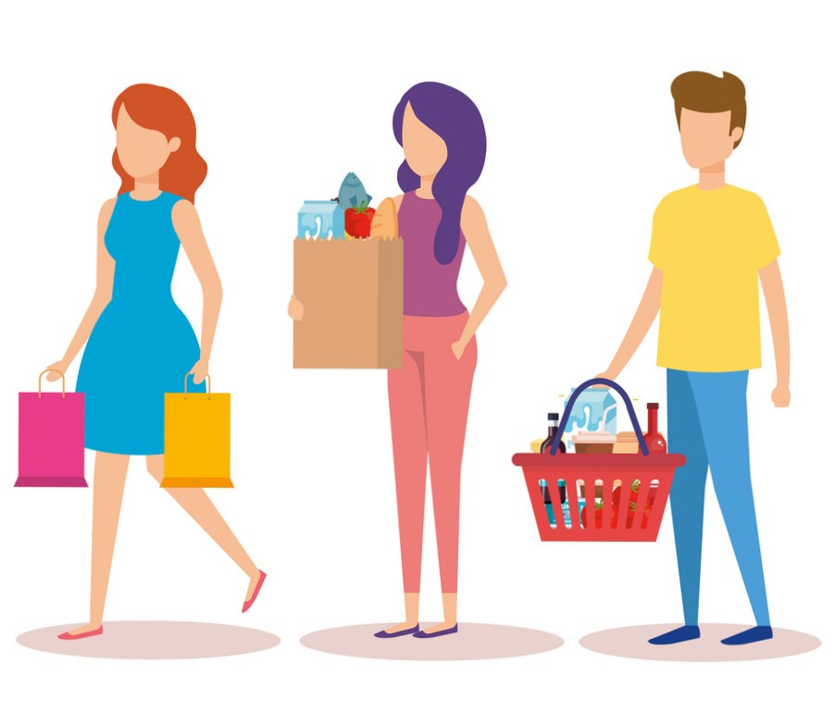
EDA on Young People Spending Habits

Slide 2
DataSet
Finances | Shopping_centres | Branded_clothing | Entertainment_spending | Spending_on_looks | Spending_on_gadgets | Spending_on_healthyEating | Age | Height | Weight | Num_of_siblings | Gender | LeftRight_handed | Education | Only_child | Village_town | House_flats
3 | 4 | 5 | 3 | 3 | 1 | 3 | 20 | 163 | 48 | 1 | female | right handed | bachelor degree | no | village | block of flats
3 | 4 | 1 | 4 | 2 | 5 | 2 | 19 | 163 | 58 | 2 | female | right handed | bachelor degree | no | city | block of flats
2 | 4 | 1 | 4 | 3 | 4 | 2 | 20 | 176 | 67 | 2 | female | right handed | secondary school | no | city | block of flats
2 | 4 | 3 | 3 | 4 | 4 | 1 | 22 | 172 | 59 | 1 | female | right handed | bachelor degree | yes | city | bungalow
4 | 3 | 4 | 3 | 3 | 2 | 4 | 20 | 170 | 59 | 1 | female | right handed | secondary school | no | village | bungalow
2 | 3 | 3 | 3 | 1 | 4 | 4 | 20 | 186 | 77 | 1 | male | right handed | secondary school | no | city | block of flats
4 | 3 | 1 | 3 | 4 | 1 | 5 | 20 | 177 | 50 | 1 | female | right handed | secondary school | no | village | bungalow
3 | 4 | 4 | 4 | 4 | 3 | 2 | 19 | 184 | 90 | 1 | male | right handed | bachelor degree | no | city | bungalow
2 | 1 | 3 | 2 | 1 | 3 | 4 | 18 | 166 | 55 | 1 | female | right handed | secondary school | no | city | bungalow
Rating Range 1 , 2, 3, 4, 5 where 1 (Strongly Disagree ) 5 (Strongly Agree)

Slide 3
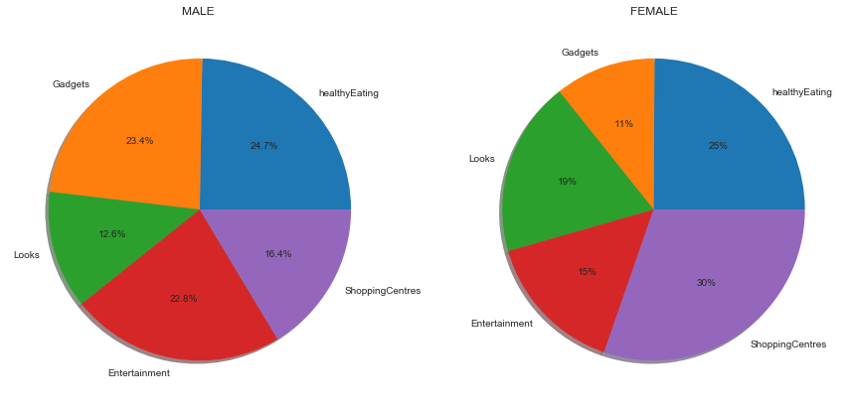
What is the overall % interest of MEN and WOMEN in various categories
Young Women prefer to go to Shopping Centers while young Men prefer on buying gadgets

Slide 4
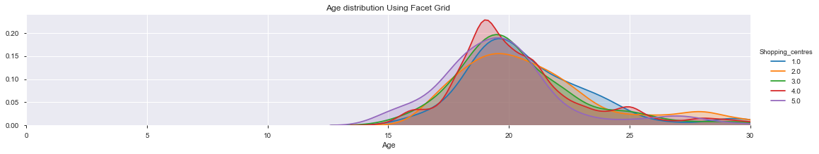
Age Range who wish to go Shopping Centre's
18 to 22 Years old adults enjoy going to Shopping Centre's Thus youths are more attracted towards shopping malls than the Middle age groups

Slide 5
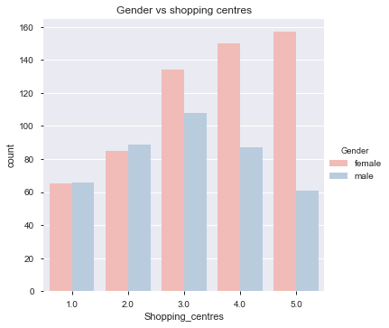
Which Gender enjoys to visit shopping Centres more ?
Females tend to enjoy going Shopping Malls

Slide 6
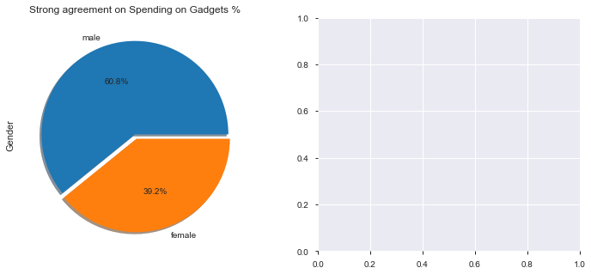
Percent of People who wish to spend more on Gadgets
Male gender wishes to spend more money on latest gadgets compared to women

Slide 7
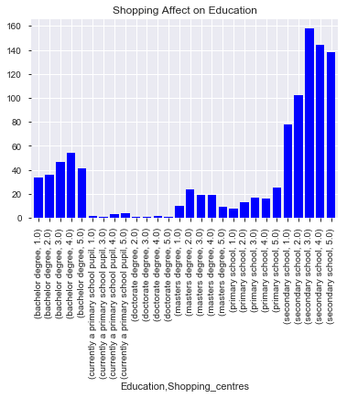
Trend of Shopping habits by Education
In my definition, high level of education is referred to college, masters and doctorate degree. In this analysis, found that who likes to go to shopping center's are people of lower level of education.

Slide 8
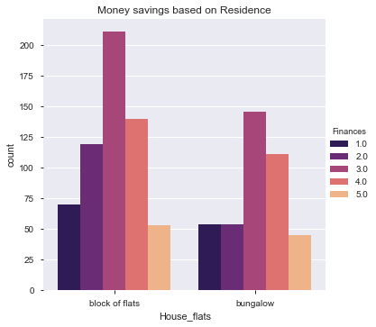
How residence affects savings ?
People staying in an apartment wish to save money than the people who reside in a bungalow

Slide 9
Conclusion
Young generation interests lies within spending time in shopping malls. Low level of education student are likely to be attracted towards shopping malls.
Young adults are likely to spend money on Gadgets , Looks and going to Shopping malls.
Shopping malls in larger cities have high rate of sales on Branded clothes , gadgets and cosmetics.
Henceforth young adults may primarily be targeted as a larger audience to market any Shopping products.

Slide 10
Thank You
-Shweta Kallurkar

